Slide 1
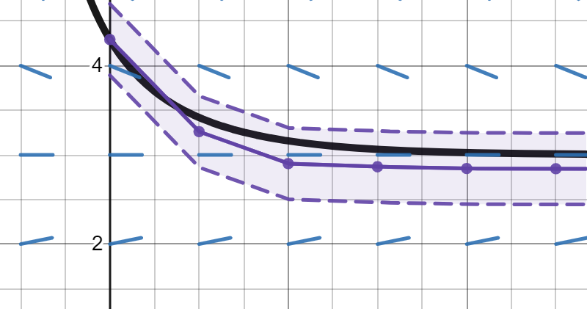
Numerical Extension ODE in KeYmaera X
Evelyn Kuo
1/20

Slide 2

Differential equations are fundamental to hybrid systems
Differential equations model the physical world
Initial value problem
Analysis of differential equations
Mathematics: ODE theory (existence, uniqueness), numerical methods
Theorem provers: KeYmaera X
2/20

Slide 3
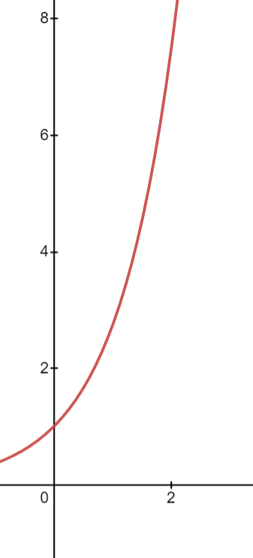
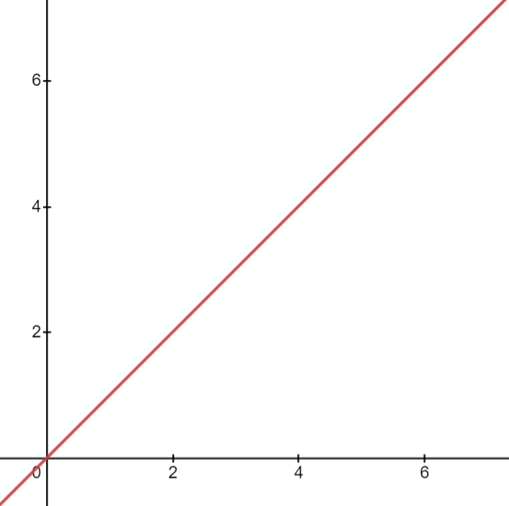
Pros/Cons of KeYmaera X ODE Tactics
Actual Solution
Easy to prove things knowing exact solution
{x’ = a}
Not always easy to find or even represent solutions
{x’ = x}
x(t) = 0 + a*t
x(t) = e^t
3/20

Slide 4
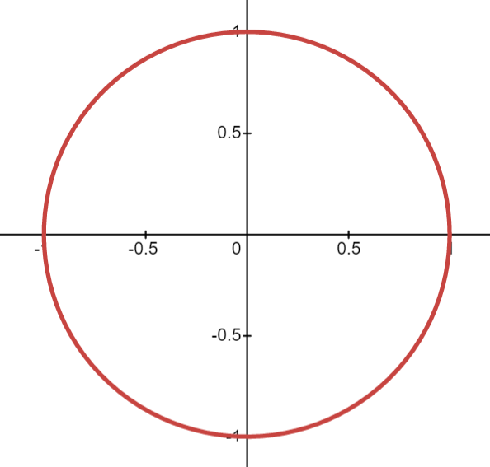
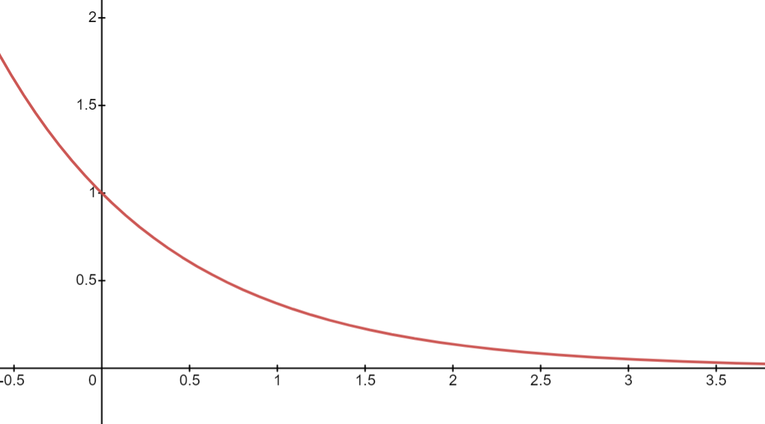
Pros/Cons of KeYmaera X ODE Tactics
Actual Solution
Differential Invariant
Easy to prove things knowing exact solution
{x’ = a}
Not always easy to find or even represent solutions
{x’ = x}
Analyze trends in how quantities change without knowing exact solution
[{x’=-y, y’=x}] x^2+y^2 = 1
Trends may not help in proof
[{x’=-x}]x > 0
x(t) = cos(t)
y(t) = sin(t)
x(t) = e^{-t}
4/20

Slide 5
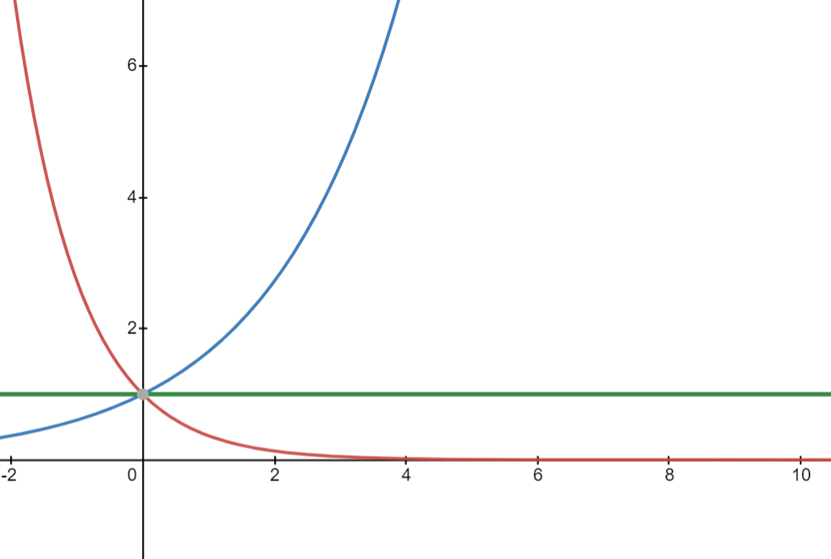
Pros/Cons of KeYmaera X ODE Tactics
Differential Ghost
Use ghost variable to analyze how quantities change without knowing exact solution
[{x’=-x, y’=y/2}]x*y^2 = 1
Ghost variable solution needs to exist for at least as long as original diffeq
x(t) = e^{-t}
y(t) = e^{t/2}
x(t)*y(t)^2 = 1
5/20

Slide 6
Pros/Cons of KeYmaera X ODE Tactics
Actual Solution
Differential Invariant
Differential Ghost
Easy to prove things knowing exact solution
{x’ = a}
Not always easy to find or even represent solutions
{x’ = x}
Analyze trends in how quantities change without knowing exact solution
[{x’=-y, y’=x}] x^2+y^2 = 1
Trends may not help in proof
[{x’=-x}]x > 0
Use ghost variable to analyze how quantities change without knowing exact solution
[{x’=-x, y’=y/2}]x*y^2 = 1
Ghost variable solution needs to exist for at least as long as original diffeq
6/20

Slide 7
3 minutes

Slide 8

Numerical methods can offer approximate solutions which are almost like actual solutions
Require timestep specification
Symbolic initial value problem
How to transform post conditions to account for error
7/20

Slide 9





Theory: constructing approximations
Given timestep h, numerical methods can yield discrete approximations
$$\overline{y3}$$
$$\overline{y}(t)$$
y(t)
$$\overline{y2}$$
$$\overline{y1}$$
$$\overline{y0}$$
8/20
t0
t1
t2
t3
t

Slide 10







Theory: global error of discrete approximation
Define error Ei := | $\overline{yi}−y(ti)|$, want to find global bound on error
$$\overline{y3}$$
$$\overline{y}(t)$$
E3 := | $\overline{y3}$-y(t3)|
y(t)
$$\overline{y2}$$
y(t3)
$$\overline{y1}$$
$$\overline{y0}$$
y(t1)
y(t2)
y(t0)
9/20
t0
t1
t2
t3
t

Slide 11

Theory: global error of discrete approximation
Introduce new sequence {y(i+1) = } (one step) approximations
Truncation error
$$\overline{y3}$$
$$\overline{y}(t)$$
y(t)
$$\overline{y2}$$
y(t3)
$$\overline{y1}$$
y2
τ
y1
y3
$$\overline{y0}$$
y(t1)
y(t2)
y0
y(t0)
10/20
t0
t1
t2
t3
t

Slide 12



Theory: global error of discrete approximation
If φ sufficiently nice, exists constant C such that
$$\overline{y3}$$
$$\overline{y}(t)$$
y(t)
$$\overline{y2}$$
C| $\overline{y2}$-y(t2)|
y(t3)
$$\overline{y1}$$
y2
τ
y1
y3
$$\overline{y0}$$
y(t1)
y(t2)
y0
y(t0)
11/20
t0
t1
t2
t3
t
Notes:
How much the errors will expand by at each timestep

Slide 13

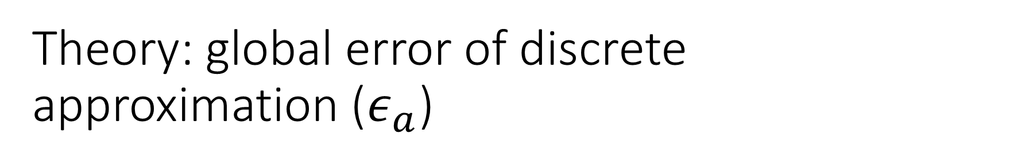

Theory: global error of discrete approximation ($ε_{a}$)
If N=T/h, global error of discrete approximation
$$E_{i+1}≤{CE}_{i}+τ ≤C^{i+1}E_{0}+τ\sum_{j=0}^{i−1}{C^{j}}≤τ\frac{C^{N}−1}{C−1}$$
$$\overline{y3}$$
$$\overline{y}(t)$$
E3 := | $\overline{y3}$-y(t3)|
y(t)
C| $\overline{y2}$-y(t2)|
$$\overline{y2}$$
C| $\overline{y2}$-y(t2)|
y(t3)
$$\overline{y1}$$
y2
τ
y1
y3
$$\overline{y0}$$
y(t1)
y(t2)
y0
y(t0)
12/20
t0
t1
t2
t3
t

Slide 14





Theory: constructing approximations
Use linear interpolation to convert to continuous approximations
$$\overline{y3}$$
$$\overline{y}(t)$$
y(t)
$$\overline{y2}$$
$$\overline{y1}$$
$$\overline{y0}$$
13/20
t0
t1
t2
t3
t

Slide 15



Theory: global error of continuous approximation
If $ε_{a}$is discrete approximation error, then continuous approximation error of linear interpolation is bounded by $ε_{a}$+hL
L: max derivative of y
$$\overline{y3}$$
$$\overline{y}(t)$$
y(t)
$$\overline{y2}$$
$$\overline{y1}$$
$$\overline{y1}$$
$$\overline{y0}$$
$$\overline{y0}$$
14/20
t0
t1
t2
t3
t

Slide 16



Theory: global error
global error of continuous approximation
$ε_{a}$+hL
Putting it together
If desired error bound is $ε$,
Solve for h
$ε$= $τ\frac{C^{N}−1}{C−1}$+hL
global error of discrete approximation
$$ε_{a}≤τ\frac{C^{N}−1}{C−1}$$
15/20

Slide 17
6 minutes

Slide 18





Theory: Proof Rule
\exists e > 0 \forall t (0 <= t <= T & |x-x_approx(x0,t,e)| < e -> P(x))
------------------------------------------------------------------------------- [dApprox]
[t:=0; x0 := x; {t'=1, x'=f(t,x) & t <= T}] P(x)
e
$$\overline{y3}$$
$$\overline{y}\left(t\right):y_approx$$
$$\overline{y2}$$
y(t)
$$\overline{y1}$$
$$\overline{y0}$$
t0
t1
t2
t3
t
16/20
Notes:
Predicate function – thing you want to prove

Slide 19
Implementation:
x’ = f(t,x) & t <=T
error tolerance
KeYmaera X
ODE Approximation
(numerical method selection)
x_approx(t,x0)
KeYmaera X
17/20

Slide 20
Implementation:
x’ = f(t,x) & t <=T
error tolerance
KeYmaera X
ODE Approximation
(numerical method selection)
x_approx(t,x0)
KeYmaera X
continuous approximation
error tolerance
x’=f(t,x) & t <= T
timestep (h) calculation from error tolerance bound
symbolic numerical method
discrete approximation
symbolic linear interpolation
h
18/20

Slide 21
9 minutes

Slide 22
Discussion and Further Work
Comparison of existing KeYmaera X tools for analyzing ODEs
Theory of how to convert desired error tolerance into continuous approximation
Implementation for ODE approximation
Convert python function approximation into KeYmaera X function
Handle non-initial value symbols in function x’=f(t,x)
Extend to other numerical methods
19/20

Slide 23
20/20

